Slide 1
Sorting Algorithms

Slide 2
Bubble Sort

Slide 3
Bubble Sort
2, 3, 1, 15
2, 1, 3, 15 // after one loop
1, 2, 3, 15 // after second loop
1, 2, 3, 15 // after third loop

Slide 4
Bubble Sort
Simple and uncomplicated
Compare neighboring elements
Swap if out of order
Two nested loops
O(n2)

Slide 5
Bubble Sort
vector a contains n elements to be sorted.
for (i = 0; i < n-1; i++) {
for (j = 0; j < n-1-i; j++)
if (a[j+1] < a[j]) { /* compare neighbors */
tmp = a[j]; /* swap a[j] and a[j+1] */
a[j] = a[j+1];
a[j+1] = tmp;
}
}

Slide 6
Bubble Sort
7
2
8
5
4
2
7
5
4
8
2
5
4
7
8
2
4
5
7
8
2
7
8
5
4
2
7
5
4
8
2
5
4
7
8
2
4
5
7
8
2
7
8
5
4
2
5
7
4
8
2
4
5
7
8
(done)
2
7
5
8
4
2
5
4
7
8
2
7
5
4
8
https://www.youtube.com/watch?v=JP5KkzdUEYI

Slide 7
Selection sort

Slide 8
Selection sort
Given an array of length n,
Search elements 0 through n-1 and select the smallest
Swap it with the element in location 0
Search elements 1 through n-1 and select the smallest
Swap it with the element in location 1
Search elements 2 through n-1 and select the smallest
Swap it with the element in location 2
…
Continue until there’s nothing left to search

Slide 9
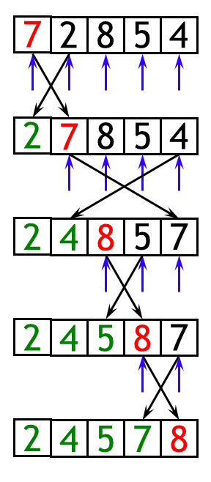
Selection sort
Given an array of length n,
The selection sort might swap an array element with itself--this is harmless, and not worth checking for
Analysis:
The outer loop executes n-1 times
The inner loop executes about n/2 times on average (from n to 2 times)
Work done in the inner loop is constant (swap two array elements)
Time required is roughly (n-1)*(n/2)
You should recognize this as O(n²)
https://www.youtube.com/watch?v=hqSkNVdbNl4

Slide 10
Insertion sort

Slide 11
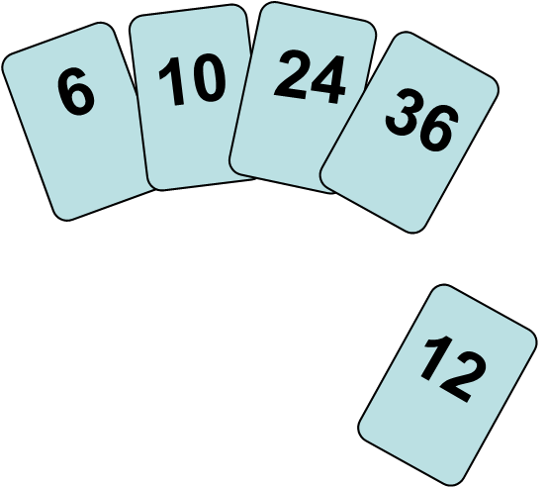
Insertion sort
To insert 12, we need to make room for it by moving first 36 and then 24

Slide 12
Insertion sort
6
10
24
36
12

Slide 13
Insertion sort
6
10
24
36
12

Slide 14
Insertion sort
6
10
12
24
36

Slide 15
Insertion sort
Insertion sort is a simple sorting algorithm that is appropriate for small inputs
Most common sorting technique used by card players
The list is divided into two parts: sorted and unsorted
In each pass, the first element of the unsorted part is picked up, transferred to the sorted sublist, and inserted at the appropriate place
A list of n elements will take at most n-1 passes to sort the data

Slide 16
Insertion sort
Although it has the same complexity as Bubble Sort, the insertion sort is a little over twice as efficient as the bubble sort
Best case: O(n). It occurs when the data is in sorted order. After making one pass through the data and making no insertions, insertion sort exits.
Average case: θ(n²) since there is a wide variation with the running time.
Worst case: O(n²) if the numbers were sorted in reverse order

Slide 17
Insertion sort
Sorted
Unsorted
23 | 78 | 45 | 8 | 32 | 56
23 | 78 | 45 | 8 | 32 | 56
23 | 45 | 78 | 8 | 32 | 56
8 | 23 | 45 | 78 | 32 | 56
8 | 23 | 32 | 45 | 78 | 56
8 | 23 | 32 | 45 | 56 | 78
Original List
After pass 1
After pass 2
After pass 3
After pass 4
After pass 5

Slide 18
Insertion sort
sorted
next to be inserted
3
4
7
12
14
14
20
21
33
38
10
55
9
23
28
16
temp
less than 10
10
3
4
7
10
12
14
14
20
21
33
38
55
9
23
28
16
sorted

Slide 19
Insertion sort
Worst Case
Reverse sorted list
Max possible number of comparisons
O(n²)
Best Case
Sorted input
1 comparison in each pass
O(n)

Slide 20
Comparison of N, logN and N²
N O(LogN) O(N²)
_______________________________________________________________________________________________________________________________________________________________________________________________________________________________________________________________________________________________________________________________________________________________________________________________________________________________________________________________________________________________________________________________________________________________________________________________________________________________________________________________________________________________-_____
16 4 256
64 6 4K
256 8 64K
1,024 10 1M
16,384 14 256M
131,072 17 16G
262,144 18 6.87E+10
524,288 19 2.74E+11
1,048,576 20 1.09E+12
1,073,741,824 30 1.15E+18

Slide 21
Shellsort

Slide 22
Shellsort sort
Founded by Donald Shell and named the sorting algorithm after himself in 1959
Shellsort works by comparing elements that are distant rather than adjacent elements in an array or list where adjacent elements are compared
Shellsort uses a sequence h₁, h₂, …, h_{t} called the increment sequence or gap
Any increment sequence is fine as long as h₁ = 1 and some other choices are better than others

Slide 23
Shellsort sort
Shellsort makes multiple passes through a list and sorts a number of equally sized sets using the insertion sort
Shellsort improves on the efficiency of insertion sort by quickly shifting values to their destination

Slide 24
Shellsort sort
h_{k}-sorted array - all elements spaced a distance h_{k} apart are sorted relative to each other
h_{k}-sorted remains h_{k}-sorted when h_{k-1}-sorted -sorted.
Subsequent sorts do not undo the work done by previous phases.
The last step (with h = 1) - Insertion Sort on the whole array

Slide 25
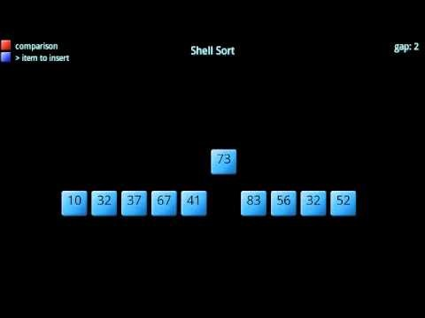
Shellsort sort

Slide 26




Shellsort sort
Before and after sorting with gap = 7
Before and after sorting with gap = 3

Slide 27
Quicksort

Slide 28
Quicksort
Quicksort the divide-and-conquer paradigm
All the hard work is done before the recursive calls
It works as follows:
First, it partitions an array into two parts,
Then, it sorts the parts independently,
Finally, it combines the sorted subsequences by a simple concatenation.

Slide 29
Quicksort
Developed in 1962 by C. A. R. Hoare
Given a pivot value:
Rearranges array into two parts:
Left part ≤ pivot value
Right part > pivot value
Average case for Quicksort is O(n log n)
Worst case is O(n2)

Slide 30




Quicksort

Slide 31
Heapsort

Slide 32
Heapsort
Definitions of heap:
A large area of memory from which the programmer can allocate blocks as needed, and deallocate them (or allow them to be garbage collected) when no longer needed
A balanced, left-justified (complete) binary tree in which no node has a value greater than the value in its parent
These two definitions have little in common
Heapsort uses the second definition

Slide 33
Heapsort
Heapsort is a comparison-based sorting algorithm
Heapsort can be thought of as an improved selection sort
like that algorithm, it divides its input into a sorted and an unsorted region, and it iteratively shrinks the unsorted region by extracting the largest element and moving that to the sorted region
Heapsort was invented by J. W. J. Williams in 1964

Slide 34
Heapsort
A node has the heap property if the value in the node is as large as or larger than the values in its children
A binary tree is a heap if all nodes in it have the heap property
12
12
12
8
3
8
12
8
14
Blue node has heap property
Blue node has heap property
Blue node does not have heap property

Slide 35
Heapsort
8
8
10
10
10
8
8
5
1
2
3
10
10
12
8
5
12
5
10
5
12
8
8
4

Slide 36
Heapsort
12
12
14
10
5
14
5
12
5
8
14
8
10
8
10

Slide 37
Vector Representation of Binary Tree
root
R
l
r
ll
lr
rl
rr
1
2
3
4
5
6
7
R
l
r
ll
lr
rl
rr

Slide 38
Vector Representation of Binary Tree
root
R
l
r
ll
lr
rl
rr
1
2
3
4
5
6
7
R
l
r
ll
lr
rl
rr

Slide 39
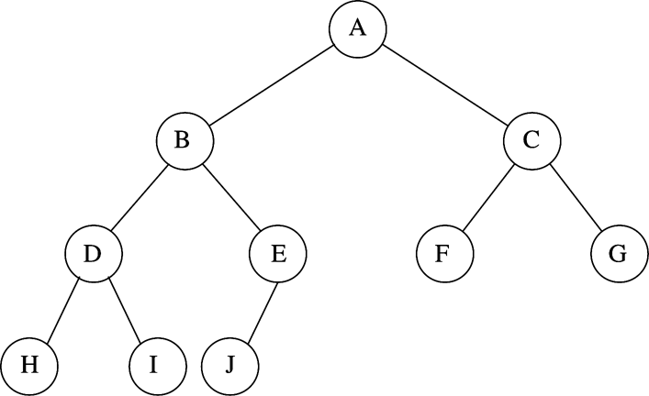
Heapsort
Parent of v[k] = v[k/2]
Left child of v[k] = v[2*k]
Right child of v[k] = v[2*k + 1]

Slide 40
Heapsort
25
22
17
19
22
14
15
18
14
21
3
9
11
0 1 2 3 4 5 6 7 8 9 10 11 12
25
22
17
19
22
14
15
18
14
21
3
9
11

Slide 41
Heapsort
0 1 2 3 4 5 6 7 8 9 10 11 12
25
22
17
19
22
14
15
18
14
21
3
9
11
0 1 2 3 4 5 6 7 8 9 10 11 12
11
22
17
19
22
14
15
18
14
21
3
9
25

Slide 42
Heapsort
0 1 2 3 4 5 6 7 8 9 10 11 12
11
22
17
19
22
14
15
18
14
21
3
9
25
0 1 2 3 4 5 6 7 8 9 10 11 12
22
22
17
19
21
14
15
18
14
11
3
9
25
0 1 2 3 4 5 6 7 8 9 10 11 12
9
22
17
19
22
14
15
18
14
21
3
22
25

Slide 43
Heapsort
https://en.wikipedia.org/wiki/Heapsort

Slide 44
Mergesort

Slide 45
Mergesort
Mergesort algorithm is one of two important divide-and-conquer sorting algorithms (the other one is quicksort)
It is a recursive algorithm
Divides the list into halves,
Sort each halve separately, and
Then merge the sorted halves into one sorted array

Slide 46
Mergesort
1 | 24 | 26 | 15 | 13 | 2 | 27 | 38
1 | 24 | 26 | 15
13 | 2 | 27 | 38
1 | 24
26 | 15
13 | 2
27 | 38
1
24
26
15
13
2
27
38
1 | 24
15 | 26
2 | 13
27 | 38
1 | 15 | 24 | 26
2 | 13 | 27 | 38
1 | 2 | 13 | 15 | 24 | 26 | 27 | 38

Slide 47
Mergesort
6 | 3 | 9 | 1 | 5 | 4 | 7 | 2
divide
6 | 3 | 9 | 1
5 | 4 | 7 | 2
divide
divide
7 | 2
6 | 3
9 | 1
5 | 4
divide
divide
divide
divide
6
3
9
1
5
4
7
2
merge
merge
merge
merge
3 | 6
1 | 9
4 | 5
2 | 7
merge
merge
1 | 3 | 6 | 9
2 | 4 | 5 | 7
merge
1 | 2 | 3 | 4 | 5 | 7 | 8 | 9
CENG 213 Data Structures

Slide 48
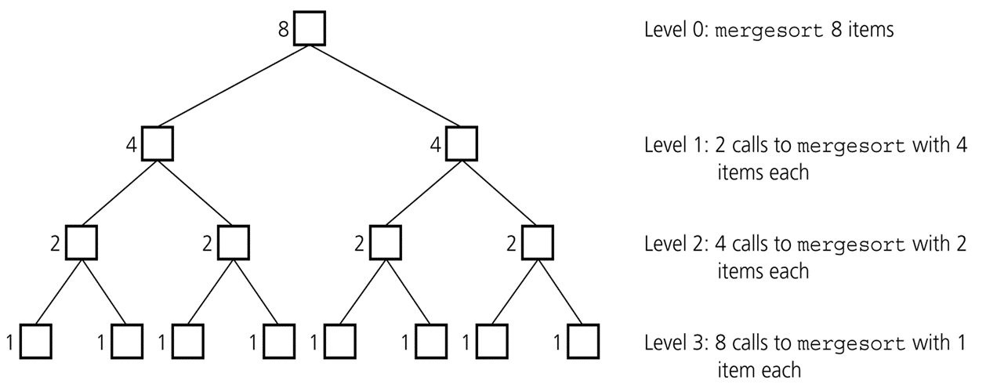
Mergesort
Levels of recursive calls to mergesort, given an array of eight items

Slide 49
Mergesort
2^{m}
level 0 : 1 merge (size 2^{m-1})
2^{m-1}
2^{m-1}
level 1 : 2 merges (size 2^{m-2})
level 2 : 4 merges (size 2^{m-3})
2^{m-2}
2^{m-2}
2^{m-2}
2^{m-2}
.
.
.
.
.
.
level m-1 : 2^{m-1} merges (size 2⁰)
2⁰
2⁰
. . . . . . . . . . . . . . . . .
level m

Slide 50
Mergesort
Mergesort is extremely efficient algorithm with respect to time
Both worst case and average cases are O (n * log₂n )
Mergesort requires an extra array whose size equals to the size of the original array
If we use a linked list, we do not need an extra array
Need space for the links
It will be difficult to divide the list into half : O(n)

Slide 51
Mergesort
Merge sort isn’t an “in place” sort—it requires extra storage
However, it doesn’t require this storage “all at once”
This means you can use merge sort to sort something that doesn’t fit in memory—say, 300 million census records—then much of the data must be kept on backup media, such as a hard drive
Merge sort is a good way to do this

Slide 52
Merge sort
30
24
7
12
14
4
20
21
33
38
10
55
9
23
28
16
Split the array into two or more parts
30
24
7
12
14
4
20
21
33
38
10
55
9
23
28
16
Sort each part individually
4
7
12
14
20
21
24
30
9
10
16
23
28
33
38
55
Merge
4
7
9
10
12
14
16
20
21
23
24
28
30
33
38
55

Slide 53
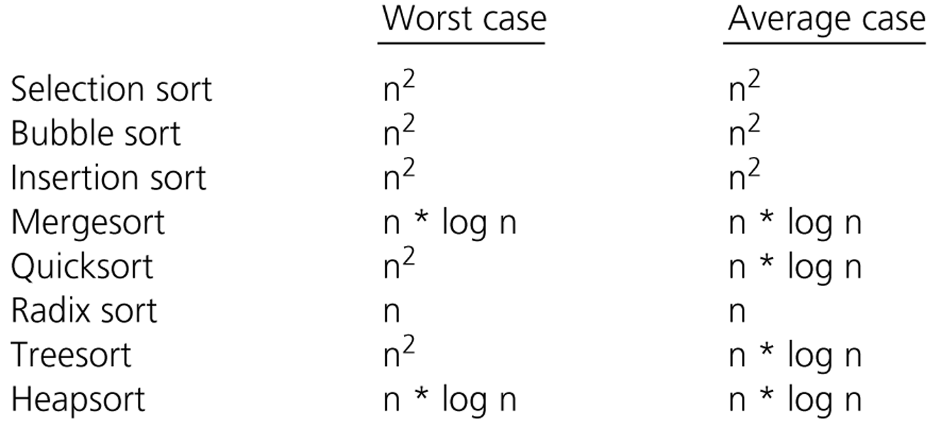
Comparison of Sorting Algorithms

